Slide 1
Class activity – Effort estimation
BSCS V- FALL 2017
SOFTWARE ENGINEERING

Slide 2
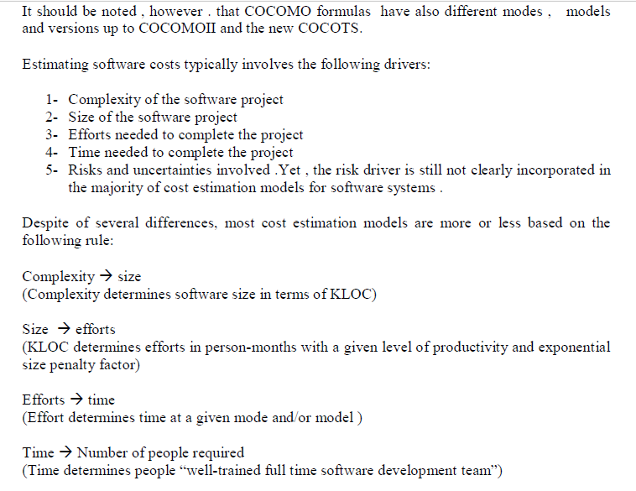

Slide 3
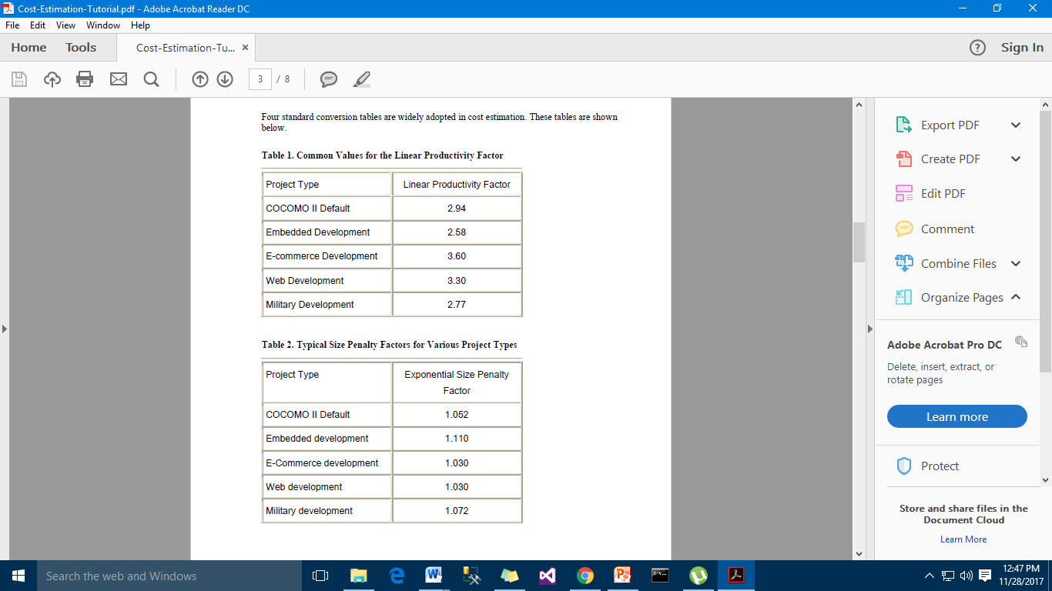

Slide 4
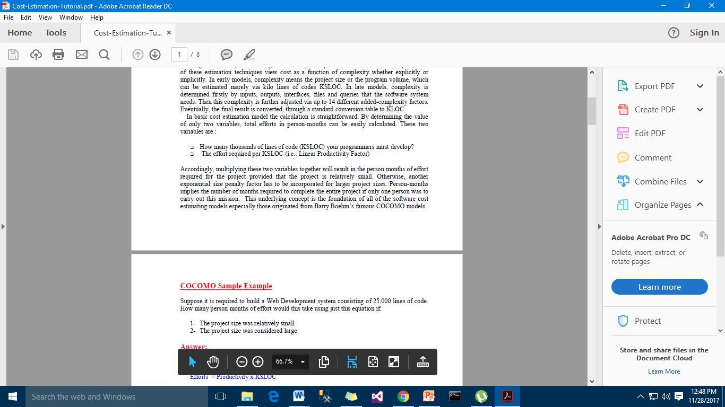

Slide 5
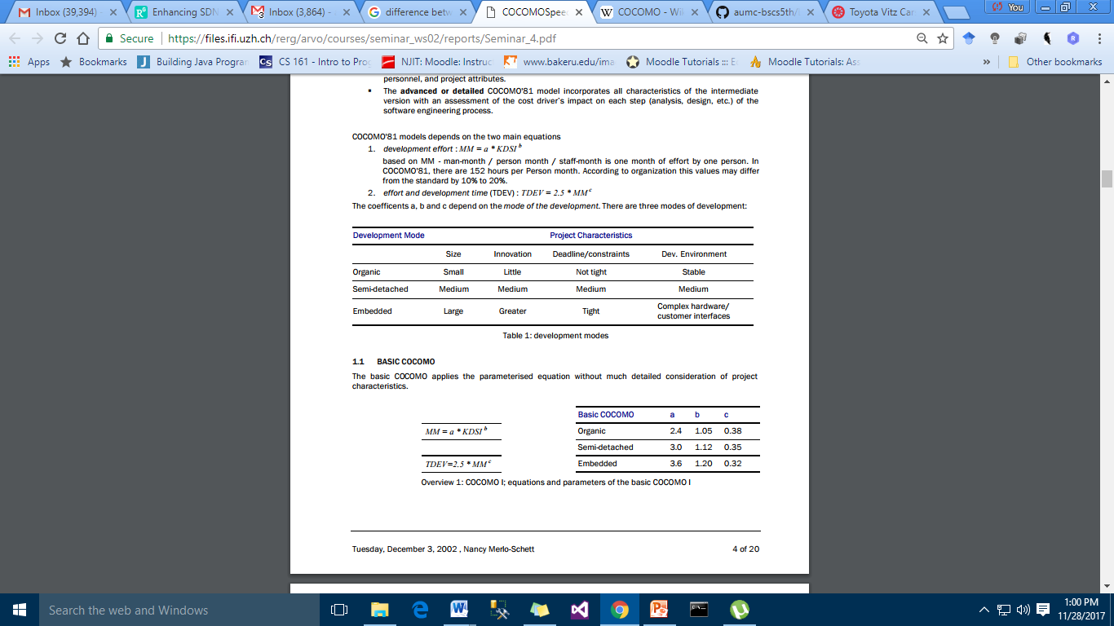

Slide 6
